Slide 1
Applying and Fine-tuning Trained Models: From U-Net Architecture to Real Seismic Data Interpretation
Webinar – 22 June 2023 Matthew Oke, David Markus and Hadyan Pratama, dGB Earth Sciences

Slide 2
Outline
Applying pretrained models (2D Fault Predictor)
Transfer training
Data Augmentation
Live Demo

Slide 3
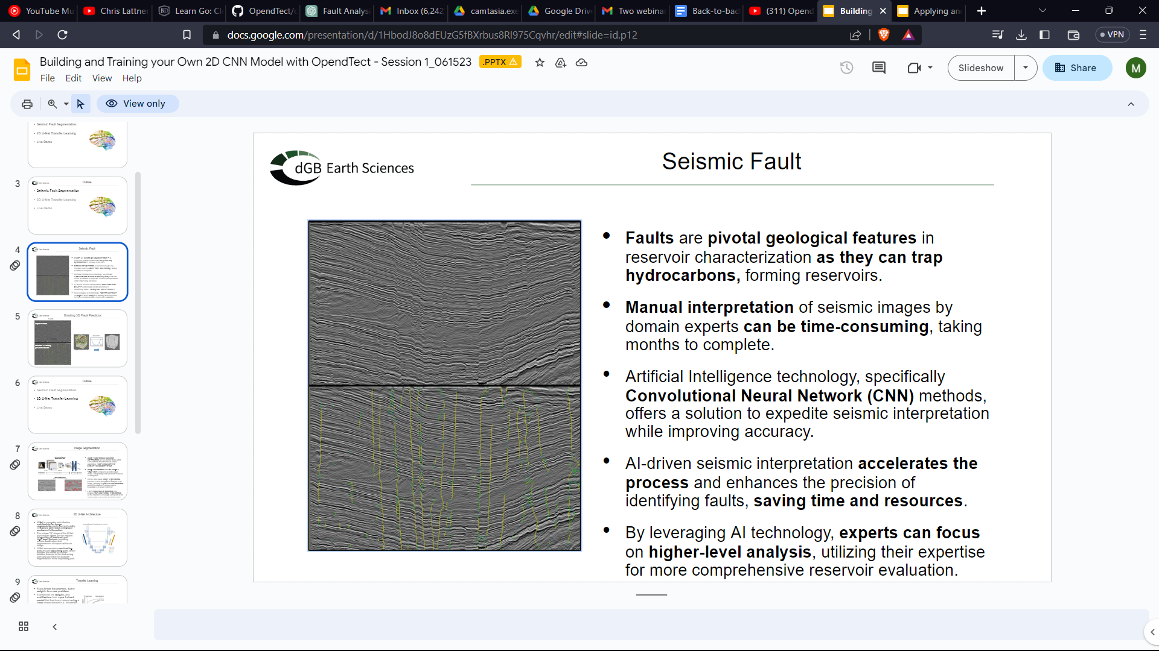
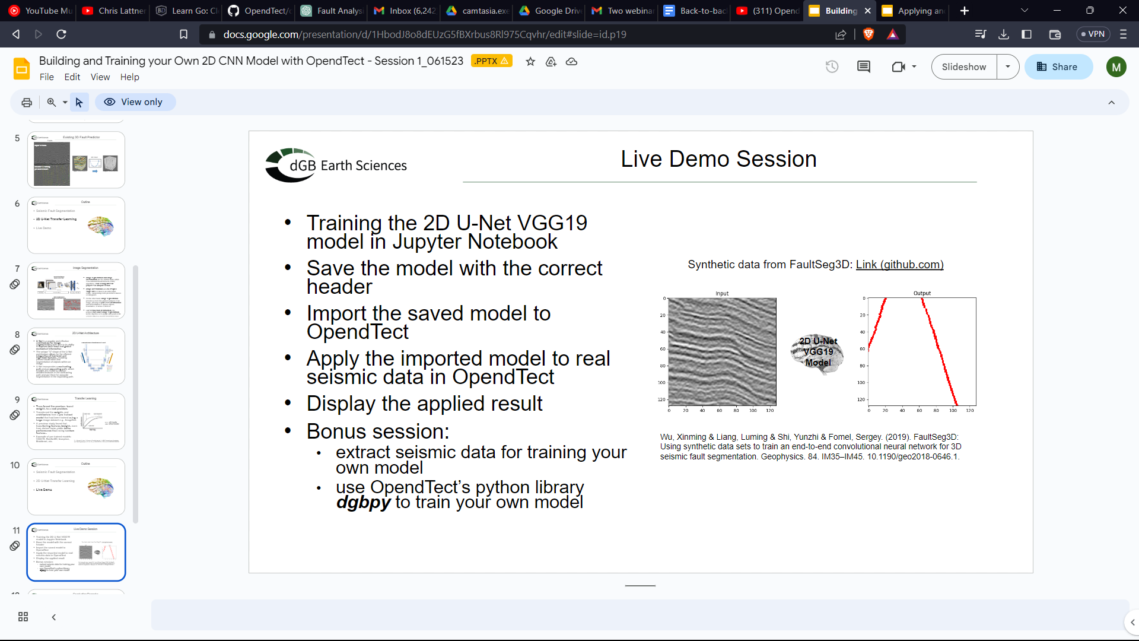
Introduction
Recap
Faults and Image Segmentation.
2D UNet Architecture.
Train a Fault Predictor with the 2D VGG19 UNet architecture on synthetic data
Save and import the model in Opendtect.
Use the dgbpy python library to train models
Synthetic data from FaultSeg3D: Link (github.com)
Wu, Xinming & Liang, Luming & Shi, Yunzhi & Fomel, Sergey. (2019). FaultSeg3D: Using synthetic data sets to train an end-to-end convolutional neural network for 3D seismic fault segmentation. Geophysics. 84. IM35–IM45. 10.1190/geo2018-0646.1.

Slide 4
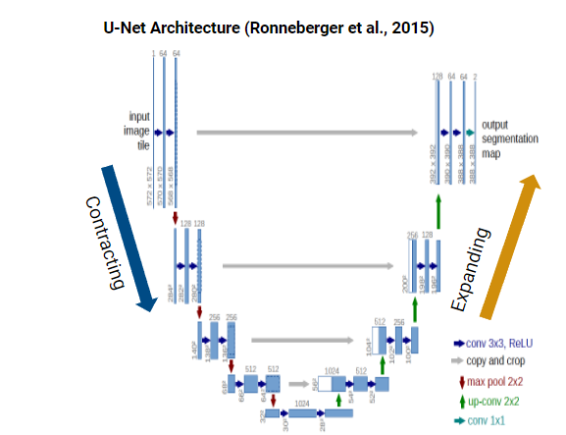
Applying the 2D Fault Predictor
Dataset:
Torosa subarea (Poseidon 3D dataset)
Model:
2D VGG19 UNet Model
Target:
Fault Prediction

Slide 5
Applying the 2D Fault Predictor
Applying pretrained models (2D Fault Predictor)
Live Demo I
Transfer training
Data Augmentation
Live Demo

Slide 6
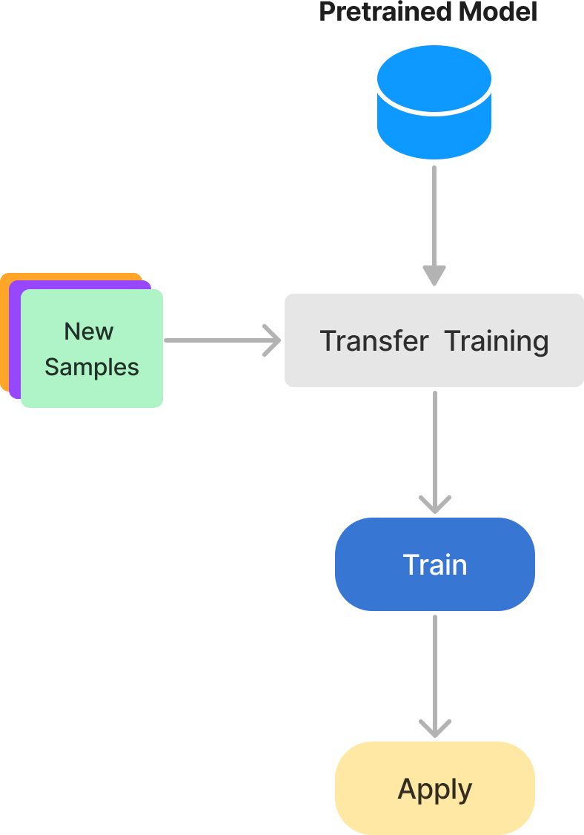
Transfer Learning
Transfer learning leverages knowledge gained from pretrained models and apply it to new datasets.
Why?
For our approach: it makes the model aware of the specific characteristics and fault patterns present in the target dataset, enhancing its fault interpretation capabilities

Slide 7
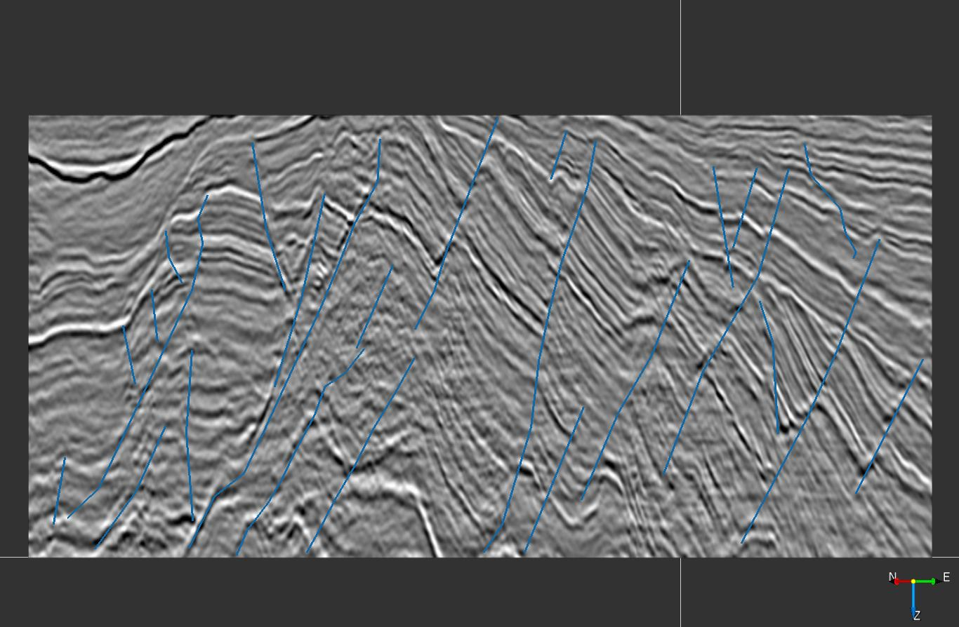
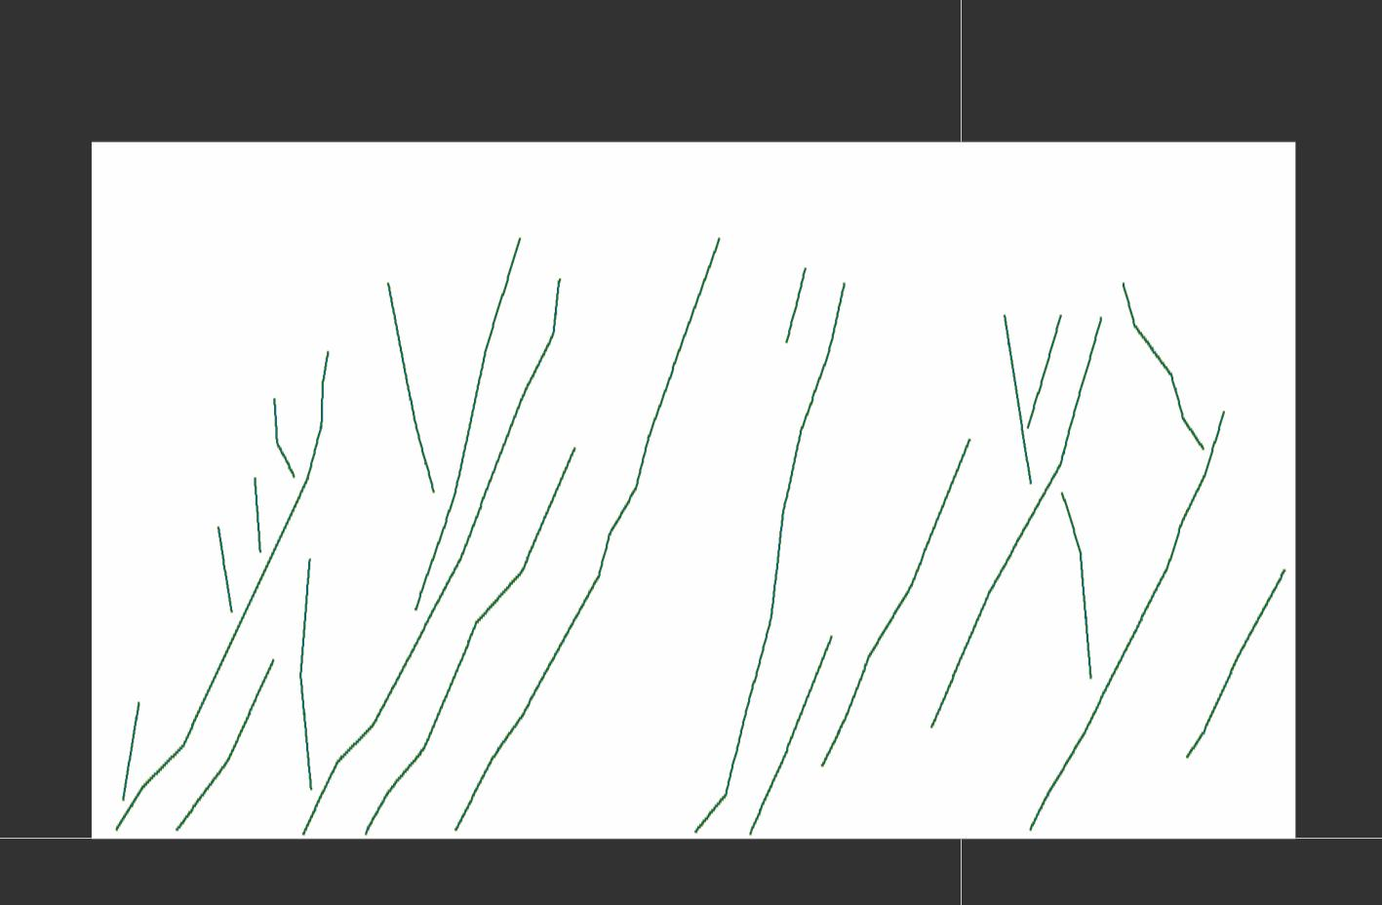
Tuning 2D VGG19 to New Data
Step 1: Interpret fault sticks on inlines and crosslines
Step 2: Convert fault interpretations to Fault Masks (values 0 or 1)

Slide 8
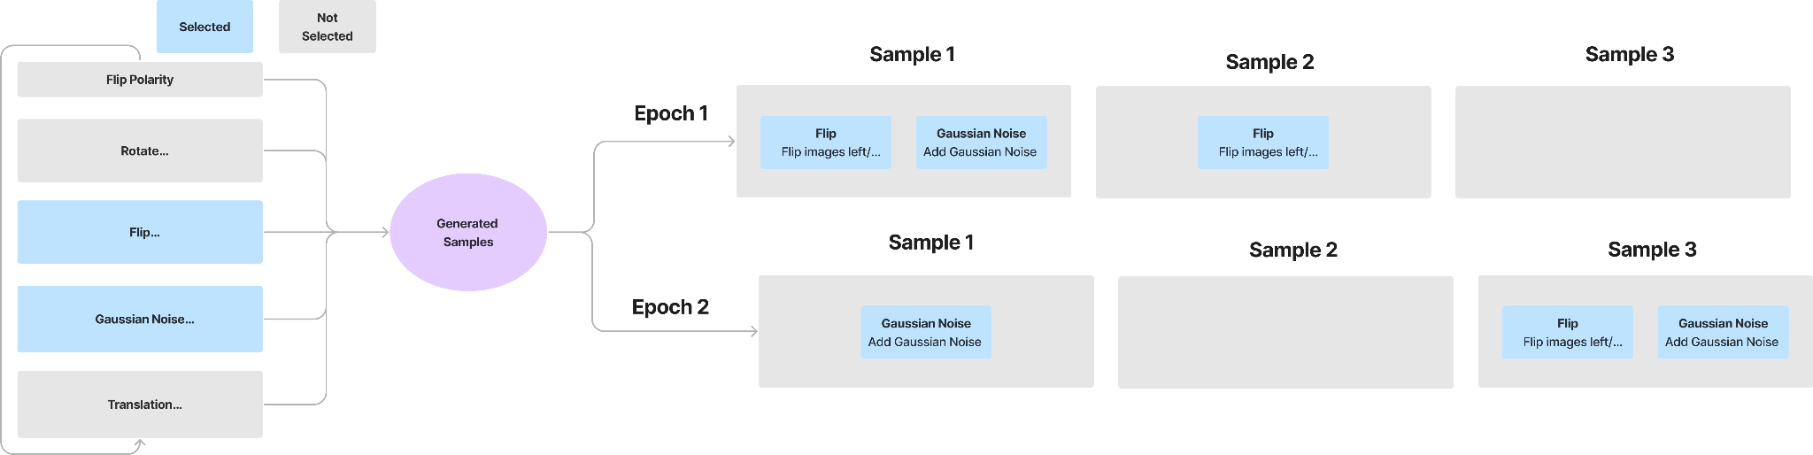
Data Augmentation
Data Augmentation involves applying a variety of transformations or modifications to the existing training data, effectively increasing the size of the training dataset. This technique enhances the modell’s ability to generalize and perform better on new, unseen samples. It also helps reduce overfitting.
How does it work?
Each selected transform is applied at random to each sample with a default probability of 0.2.

Slide 9
Finetuning Pretrained Models
Applying pretrained models (2D Fault Predictor)
Transfer training
Data Augmentation
Live Demo II

Slide 10
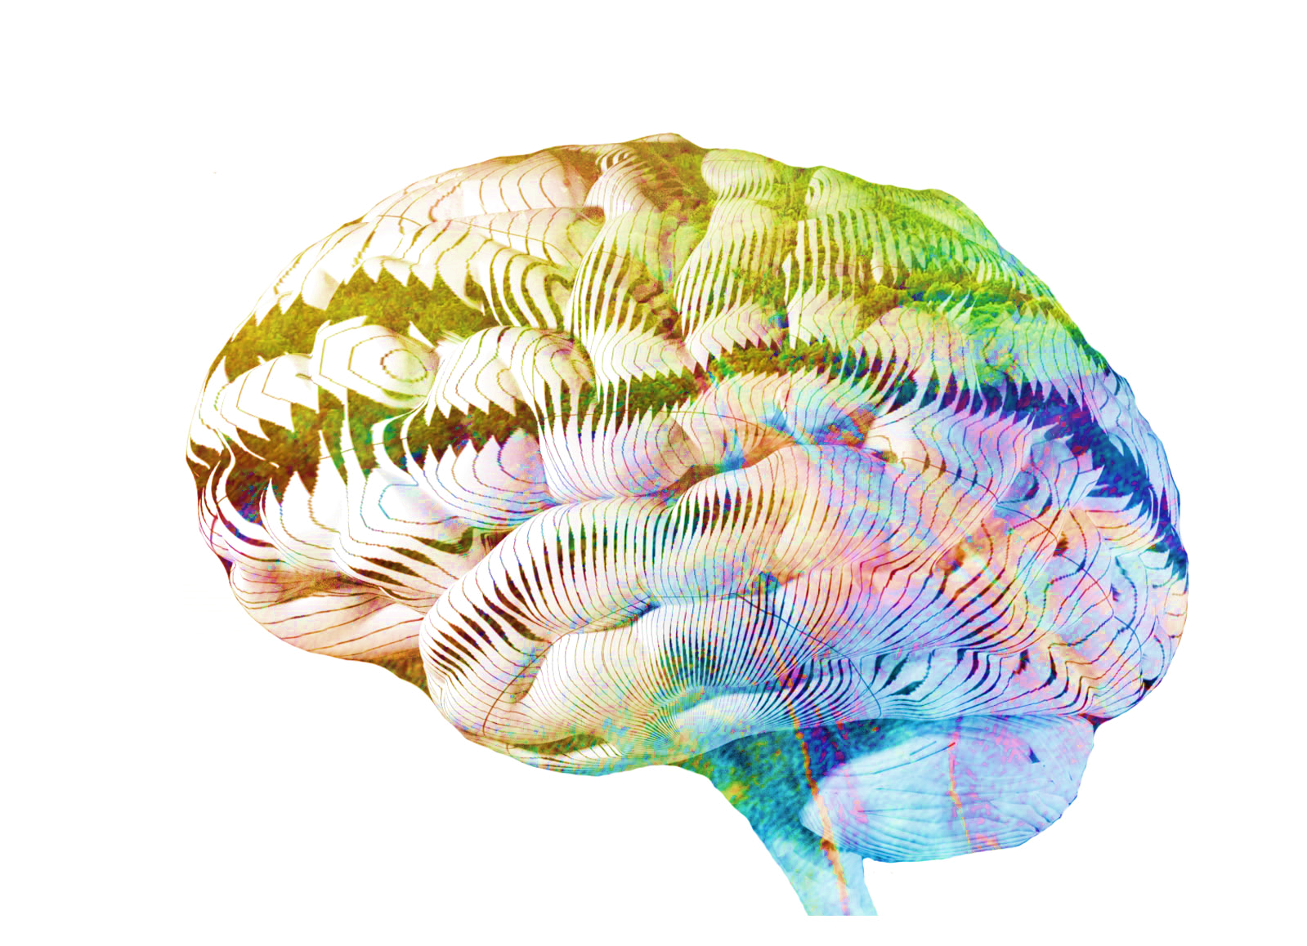
Summary
Applying pretrained models (2D Fault Predictor)
Generate fault labels for new samples in Opendtect.
Transfer training
Data Augmentation
Applying fine-tuned models

Slide 11
Thank you for watching
For more information visit dgbes.com or email info@dgbes.com

